Slide 1
A Level Further Maths

Slide 2
What’s studying A Level Further Maths at TCOLC all about?

Slide 3
A Level Further Mathematics
THE COURSE
A Level Further Maths is always studied in addition to A Level Maths!!!
You will have a total of nine lessons each fortnight. In Year 13 this increases to ten lessons a fortnight.
You will be studying for the Edexcel exam board.
No coursework – 100% examination.
There are four examinations at the end of the course (you can use a scientific calculator or graphics calculator in all three!)
At the end of Year 13 each exam is 1 hour 30 mins:
Core Pure Maths Paper 1
Core Pure Maths Paper 2
Further Statistics 1 Paper (Option)
Decision Maths 1 Paper (Option)

Slide 4
A Level Further Mathematics
A LEVEL TARGET GRADES
Target grades will be set using the average GCSE point score from all your GCSE subjects.
These are the most common target grades for our students:
Grade 6 in Maths at GCSE – Target Grade C
Grade 7/8 in Maths at GCSE – Target Grade B
Grade 8/9 in Maths at GCSE – Target Grade A

Slide 5
A Level Mathematics
EXPECTATIONS
You will be expected to keep your lesson notes, examples and homeworks/tests organised in a folder with dividers. You may use an exercise book for lesson notes if you prefer.
You will be set weekly homework.
You will be expected to practise techniques learnt in class. As a rule of thumb, you should expect to do at least one hour of work out of class for every hour in class.
We will also be using the excellent online Integral learning platform, which lets you extend and reinforce your understanding through independent study. You will be given a username and password in September.
This year we have also used UpLearn and MyMaths.

Slide 6
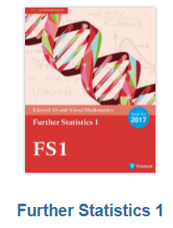
A Level Mathematics
BOOKS AND EQUIPMENT
The textbooks you require for Year 12 are published by Pearson Education.

Slide 7
ActiveLearn – online textbooks

Slide 8
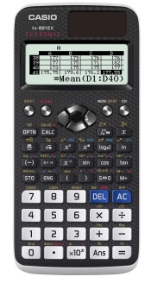
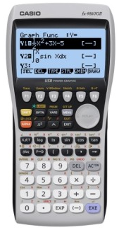
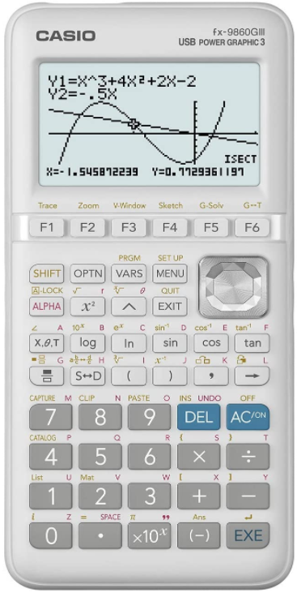
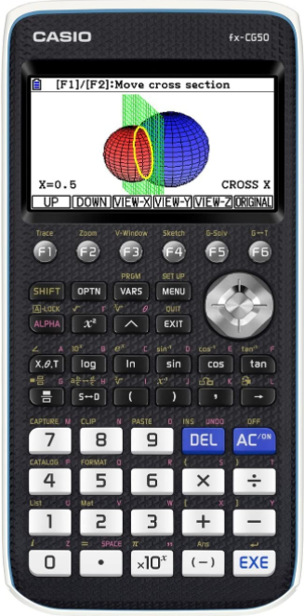
A Level Mathematics
BOOKS AND EQUIPMENT
A scientific calculator for the new specification is essential.
A graphical calculator can also be very useful!
Scientific
Casio fx-991EX Classwiz (around £20 from Amazon)
Graphical
Casio fx-9860II (around £80)
Graphical
Casio fx-9860III (around £80)
Graphical
Casio fx-CG50 (around £110)

Slide 9
Quick Quiz – Further Maths @ TCOLC
What exam board do we use for A Level Further Maths?
What’s two Further Maths options are we using this year and probably next year?
Notes:
There are SEND students who are not high level needs, do not require intervention or additional support. (SEND- K) This is where we need to invest our time and make change if we are going to move our judgement from RI.
How are you going to meet that child's needs. What training, additional knowledge might you need?
What action do you need to take before Tuesday. E.g read through information provided, speak to form tutor, teacher who taught them previously, create some more resources, re-visit your lesson plans. Post it note- Share with HOD.

Slide 10
Quick Quiz – Further Maths @ TCOLC
What exam board do we use for A Level Further Maths? Edexcel
What’s two Further Maths options are we using this year and probably next year? Decision Maths 1 Further Statistics 1
Notes:
There are SEND students who are not high level needs, do not require intervention or additional support. (SEND- K) This is where we need to invest our time and make change if we are going to move our judgement from RI.
How are you going to meet that child's needs. What training, additional knowledge might you need?
What action do you need to take before Tuesday. E.g read through information provided, speak to form tutor, teacher who taught them previously, create some more resources, re-visit your lesson plans. Post it note- Share with HOD.

Slide 11
Further Questions
ylarge@cityleicester.leicester.sch.uk

