Slide 1

BTEC National Business

Slide 2
BTEC National Business
The BTEC National Level 3 Business course focuses on the vocational aspects of Business with the aim to provide an introduction to study the business sector through applied teaching and learning using a range of methods to include; case studies, visiting speakers, role plays, application to variety of different businesses and visits to industry.
This a valuable course for students who wish to study the more practical aspect of business and who aim to progress to higher education and ultimately to employment in the business sector.

Slide 3
What You will study:
Extended Certificate/Diploma Y1
BTEC National Level 3 Extended Certificate in Business (Year 1)
Unit No. | Unit Title | Type | Assessment
1 | Exploring Business | Mandatory | Internal Coursework
2 | Developing a Marketing Campaign | Mandatory Synoptic | External Controlled Assessment
3 | Personal & Business Finance | Mandatory | External Exam
8 | Recruitment & Selection | Optional | Internal Coursework

Slide 4
What You will study:
Diploma (Y2)
BTEC National Level 3 Diploma in Business (Year 2)
Unit No. | Unit Title | Type | Assessment
4 | Managing an Event | Mandatory Synoptic | Internal Coursework
5 | International Business | Mandatory Synoptic | Internal Coursework
6 | Principles of Management | Mandatory | External Controlled Assessment
14 | Investigating Customer Service | Optional | Internal Coursework

Slide 5
Assessment
Each unit of study will consist of a number of individual assignments to enable students to demonstrate their understanding of different topics.
These assignments will be graded as Pass, Merit or Distinction; with the opportunity to re-submit work to improve overall grade.
On completion of these assignments you will achieve an overall grade for that particular unit, earning you points to bank towards the overall grade for the full qualification.
*Should you not achieve, you will have an opportunity to resubmit, however, not achieving after your resubmission may put your place/grade on the course at risk!
At the end of Year 12, you will have the option to ‘cash in’ these points to achieve a Pass, Merit or Distinction overall on the Extended Certificate BTEC as well as UCAS Points, or continue onto the Diploma.

Slide 6
Types of assessment…
Reports
Articles
Role Plays
Presentations
Research Tasks
Campaigns
Evidence collection from practical activities

Slide 7
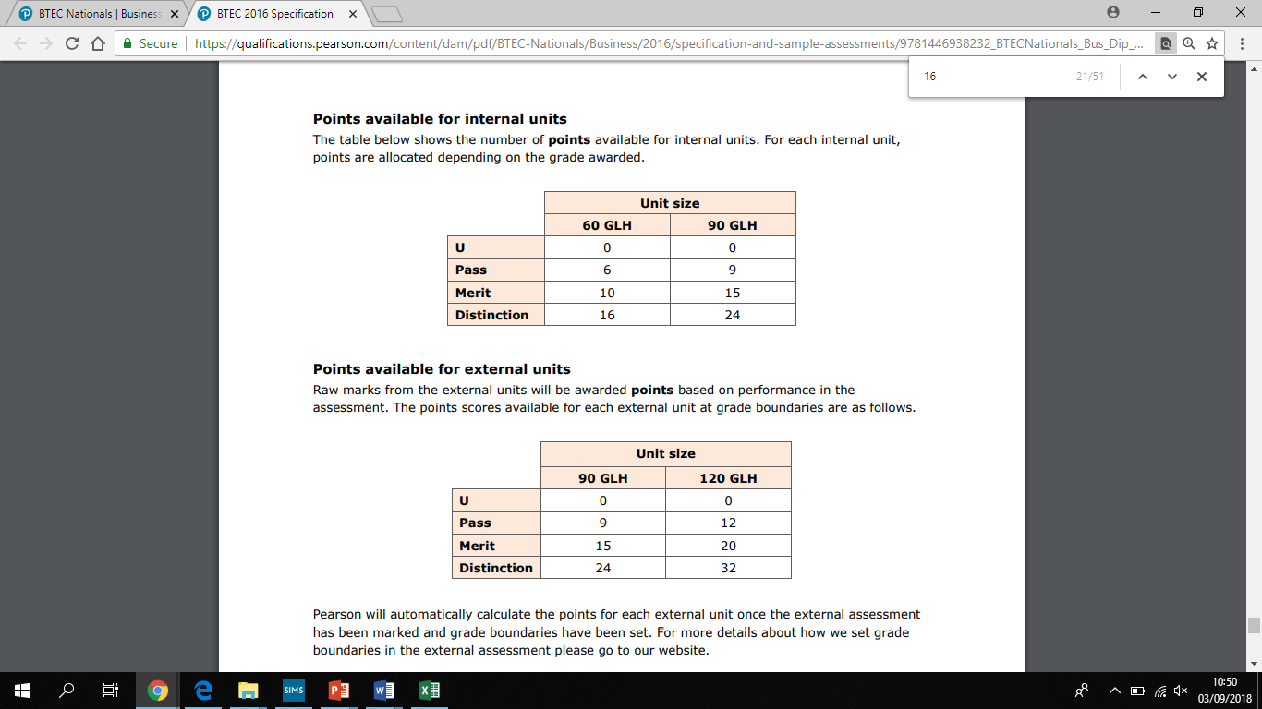

Slide 8
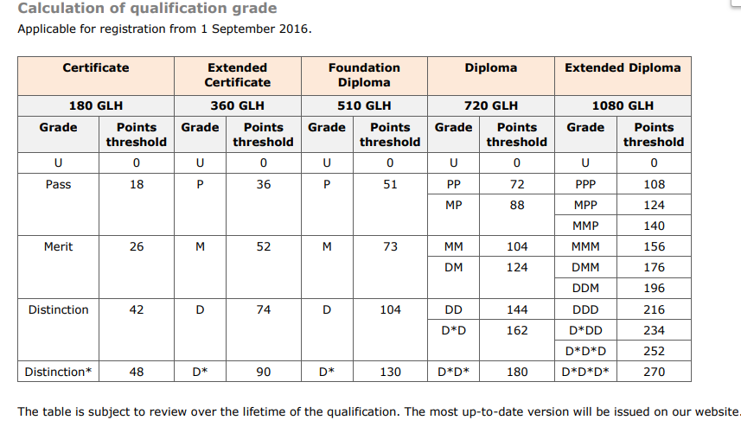

Slide 9
BIG QUESTION!
Think about all of the different ways you can pay for goods and services today?
Pause this video and complete the task – you have 2mins.

Slide 10
Different Ways to Pay
Different Ways to Pay
Cash | Pre-Paid Card
Debit Card | Contactless Card
Credit Card | Charge Cards
Cheque | Store Card
Electronic Transfer | Mobile Banking
Direct Debit | BACs
Standing Order | CHAPS

Slide 11
Task for you….
What are the advantages/disadvantages of these payment methods?
Pause this video and complete the task – you have 15mins.

Slide 12
Advantages & Disadvantages of Payment Methods
Using slides 13 – 26 compare your analysis of the different payment methods and include additional information to what you have already found.

Slide 13
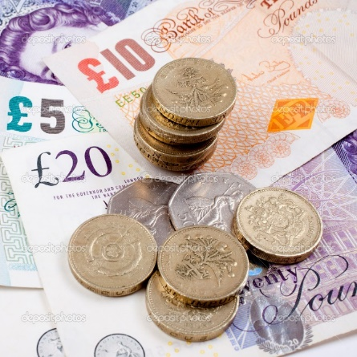
Methods of Payments: Cash
Notes and coins in a wide range of denominations
Most popular form of payment in UK with customers
Enables transactions to be completed instantly
ADVANTAGES | DISADVANTAGES
Convenient, Instant, simple | Risk of theft/loss/counterfeit
Consumers feel confident using this method | Cannot be used online
Most widely accepted form of payment | Only appropriate on purchases up to a certain amount

Slide 14
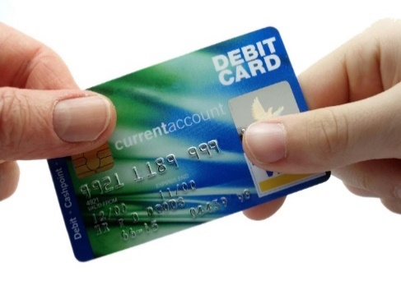
Methods of Payments: Debit card
Issued by Banks/Building Societies
Money comes directly form your account
Set to overtake cash in the UK as most popular payment by 2021
ADVANTAGES | DISADVANTAGES
More secure/safe as no need to carry cash | Short time lapse between transaction and withdrawal from account
Widely accepted and suitable online | Not accepted for smaller payments
Offers degree of protection | Businesses are charged fro transaction for use of card

Slide 15
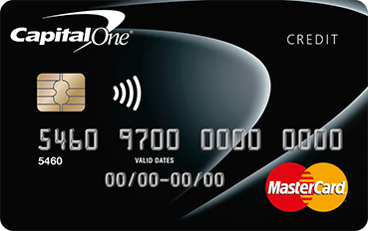
Methods of Payments: Credit Card
Issued by Banks
Allows customers to delay payments for good and services
ADVANTAGES | DISADVANTAGES
Allows period of credit that is interest free | Interest (usually high) on unpaid balance
Increased level of protection | Can encourage overspend
Loyalty schemes offered | Credit limit will be set
Widely accepted and also online | Interest charged or cash withdrawals

Slide 16
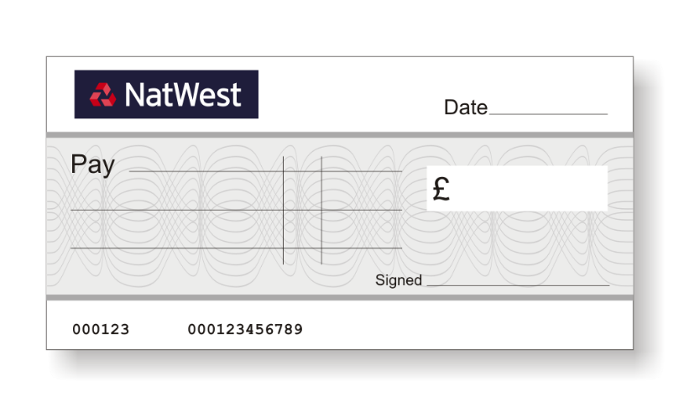
Methods of Payments: Cheque
Written order to a bank to make payment for a specific amount from one persons account to another account
Declining/declined in UK
ADVANTAGES | DISADVANTAGES
Secure; low risk | Un-cleared cheques can be costly
Specific amounts stated so no change required | Time delay for cheque to clear could cause problems
Useful for larger payments | Unable to use online/electronically
Widely accepted for face-to-face/postal transactions | Expires after certain time

Slide 17

Methods of Payments:
Electronic Transfer
Payments transferred from one account to another
More popular today due to increase of online banking/mobile apps
Allows funds to be instantly transferred
ADVANTAGES | DISADVANTAGES
Safer thank cash | Requires devices with online access
Cheap as most banks do not charge for payment | Accuracy of account details required to be inputted into system otherwise risk of loss
Instant | Initial set up and security checks can take time
Easy to use/set-up for one off or more frequent payments | Not appropriate for face-to-face transactions

Slide 18
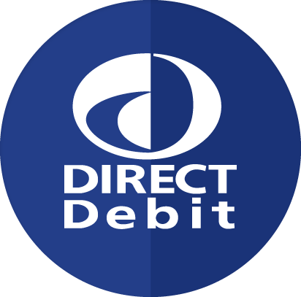
Methods of Payments: Direct Debit
Agreement with bank to allow third party to withdraw money from account on set dates once “mandate” has been established
ADVANTAGES | DISADVANTAGES
Reduces need for people to remember payment dates | Accuracy required in setting up mandate, any errors can cause delays and potential problems
Once in place reduces administration and management costs | If more money Is withdrawn then the required amount then the payee claim back
Amount that is collected can vary and be changed | The payer determines the amount each time so it is difficult for the payee to plan and budget
Quick and easy to set up | Charges for unsuccessful withdrawals/administration fees

Slide 19
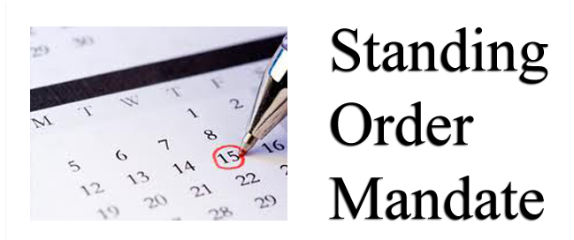
Methods of Payments: Standing Order
Agreement made with bank for a fixed sum of money to leave account and pay third party on a regular date
Only on instruction for a set amount
ADVANTAGES | DISADVANTAGES
Reduces the need for people to remember payment dates | Errors in setting up the standing order could cause potential problems
Useful if making set repayment amounts | Payment will still be attempted however could be refused due to lack of funds which can lead to bank charges/fees
Same amount paid each time making it easier to plan and budget | Unless cancelled payments will continue to be made
Easy to set-up and cancel | Administration time in the set up and management of standing order

Slide 20
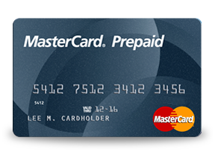
Methods of Payments: Pre-Paid Cards
Similar to a debit/credit card but does not allowing borrowing
Money is pre-loaded onto the card and then transactions are made
Useful way of budgeting
ADVANTAGES | DISADVANTAGES
Can set a budget in advanced to reduce overspending | No protection of lost
Loss/theft is limited to balance only | Sometimes requires an initial fee to set up
Ideal way to control spending | Money required initially to load card
Ideal for people with poor credit rating or looking to build one | Administration time to top-up/set-up and application for the card can take a while.

Slide 21
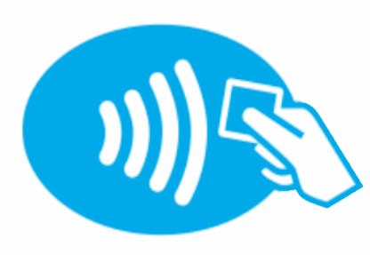
Methods of Payments:
Contactless Card
A type of credit/debit card which allows payments without the use of chip and pin.
Card contains an antennae which allows money to transfer when the card touches a contactless terminal
ADVANTAGES | DISADVANTAGES
Gaining in popularity | Not used by all merchants
Secure method of payment | Only works for a small transaction
If lost/stolen, this method has limit per spend | Security is still questionable

Slide 22
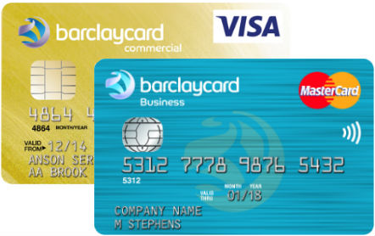
Methods of Payments: Charge Card
Similar to a credit card, issued by financial institutions – purchases paid for by card issuer
Has no spending limit
Needs to be paid for in full by due date or charges/fees will incur.
ADVANTAGES | DISADVANTAGES
Allows short period of credit | Often an annual fixed fee is set
Provides cardholder with increased level of protection | Must be paid in full each month
Can be used for large transactions as no limit set | Expensive fees if payment not made in full on due date
Often offers other perks | Not widely accepted by all merchants

Slide 23
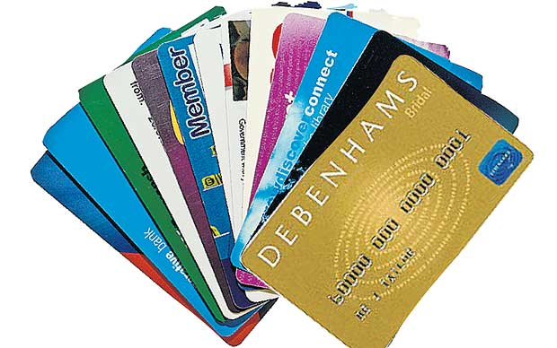
Methods of Payments: Store Cards
Like a credit card but can only be used in one store/chain of stores owned by the issuing organisation.
Card is branded by the store and partnered with a credit card
ADVANTAGES | DISADVANTAGES
Allows a short period of credit | Only accepted and used in store of issue
Discounts/rewards offered for use of card and promotions/privileges | Expensive rates of if interest on borrowed money
Increased level of consumer protection | Can encourage over spending
Offers short term credit | Can lead to habits of having multiple cards and debt

Slide 24
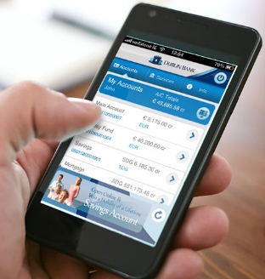
Methods of Payments: Mobile Banking
Ability to carry out financial transactions using mobile devices.
Apps which allow direct payment to be made from one account to another
ADVANTAGES | DISADVANTAGES
Convenient; can be used at any time/place | Access to internet/data connection required
Secure | Security is questionable on all systems
Quick and easy | Requires accuracy as errors could lead to payments being made to incorrect locations
Instant and each to track and manage | Some features are still limited still so does not allow all functionality

Slide 25

Methods of Payments: BACs
Bankers automated clearing service
System which allows the transfer of payments from one account into another
ADVANTAGES | DISADVANTAGES
Faster payments, almost instant and guaranteed within 2 hours | Faster payments are not set up by all banks – some take 3 days
Assessable through branch, over the phone or online | Limit is set on transferable amount
Once approved and set-up, quick and easy to use | Can be time consuming to initially set up

Slide 26

Methods of Payments: CHAPS
Clearing House Automated Payment System (CHAPS)
System which allows transfer of money between one account to another
Guarantees same day payment and no limit on amount of money transferred
ADVANTAGES | DISADVANTAGES
Same day payment | Normally has a fixed charger per transaction
No limit on transaction size | Both banks need to be a member of CHAPS scheme
Trusted service | Needs to be instructed before 2pm on working day

Slide 27
Putting your learning into practice…
Using the various payment methods and analysis notes, take a look at slides 28-29 and the various scenarios – using your notes and weighing up the judgements, which payment method would be best to use in each case and why?
Use slides 30-31 to check and compare your answers/discussion point
Pause this video and complete the task – you have 5-10mins.

Slide 28
Scenarios…
Situation | Appropriate Method of Payment – Why?
Sheetal is at university and has low funds but really needs to purchase an outfit for a night out.
Alec’s brother has rang him at 1am to say he is really struggling with money and needs to borrow some money quickly.
Anita has just purchased a sofa on finance and will need to make regular monthly payments as part of her agreement with DFS.
Jenny’s grandmother is suspicious of all these new technological ways to pay and does not like to use them. She wants to send Jenny £50 for her birthday.
Umar is falling into debt due to charges from his bank and mobile phone company charging him fees for missed payments on his mobile phone and other utility bills. He always forgets to pay bills.
Clare has just started shopping online with H&M and has received her first invoice. They have provided her a few ways to pay and bank account details for the company also. Clare is busy with work and this is a one-off payment she needs to make quickly.

Slide 29
Scenarios Continued…
Situation | Appropriate Method of Payment – Why?
Sameera and her partner are looking to purchase their first home soon. Both of them have always been good with money but have no history of credit and need to start to build this to show they are good at making repayments. They have decided that now they will start to make payments using a different method besides cash/debit cards to build a good credit history.
Ibrahim is always rushing around in the morning, he hates carrying cash and his morning routine includes; buying a coffee, breakfast and lunch for the day. He normally shops at Costa, M&S and Supermarkets for these items. He likes to live by his means.
Sumayya paid for a work invoice using her own debit card for £300 and her employer said they would reimburse her payment.
Sham has just found the house of his dreams! He has started to go through the sale process and the solicitor needs to transfer the payment over to process the sale of the house before he receives the keys. The payment needs to be secure and a guaranteed payment. The is the most expensive purchase he is making in his life ; he could not just withdraw this type of cash from the bank easily.

Slide 30
Scenarios Answers…
Situation | Appropriate Method of Payment – Why?
Sheetal is at university and has low funds but really needs to purchase an outfit for a night out. | Store Card
Alec’s brother has rang him at 1am to say he is really struggling with money and needs to borrow some money quickly. | Mobile Banking
Anita has just purchased a sofa on finance and will need to make regular monthly payments as part of her agreement with DFS. | Standing Order
Jenny’s grandmother is suspicious of all these new technological ways to pay and does not like to use them. She wants to send Jenny £50 for her birthday. | Cheque
Umar is falling into debt due to charges from his bank and mobile phone company charging him fees for missed payments on his mobile phone and other utility bills. He always forgets to pay bills. | Direct Debit
Clare has just started shopping online with H&M and has received her first invoice. They have provided her a few ways to pay and bank account details for the company also. Clare is busy with work and this is a one-off payment she needs to make quickly. | Electronic transfer (phone/online)

Slide 31
Scenarios Answers Continued…
Situation | Appropriate Method of Payment – Why?
Sameera and her partner are looking to purchase their first home soon. Both of them have always been good with money but have no history of credit and need to start to build this to show they are good at making repayments. They have decided that now they will start to make payments using a different method besides cash/debit cards to build a good credit history. | Credit Card
Ibrahim is always rushing around in the morning, he hates carrying cash and his morning routine includes; buying a coffee, breakfast and lunch for the day. He normally shops at Costa, M&S and Supermarkets for these items. He likes to live by his means. | Contactless/Debit Card
Sumayya paid for a work invoice using her own debit card for £300 and her employer said they would reimburse her payment. | Cheque/BACs
Sham has just found the house of his dreams! He has started to go through the sale process and the solicitor needs to transfer the payment over to process the sale of the house before he receives the keys. The payment needs to be secure and a guaranteed payment. The is the most expensive purchase he is making in his life ; he could not just withdraw this type of cash from the bank easily. | Chaps

Slide 32
Why you completed this task.
Although this task was simple, it does has real world application as well as practice to an exam question you could be asked towards Unit 3 Personal & Business Finance exam.
From a personal and business point of view, it is important that the most appropriate method of payment is being selected in various situations; you may end up paying a fee or extra money in some cases which you could have avoided if the appropriate payment method is was selected.
It is also important to know the different methods of payments available to pay for various goods and services as some may be more convenient then others i.e. large payments in cash are very rare today and also unsafe with no paper trail if an investigation was required!

Slide 33

Useful Website
Have a look at the Pay Your Way website to gather more information and enhance your knowledge and understanding of payment methods.
http://www.payyourway.org.uk/ways-pay/faster-payments

Slide 34
Show You Know
Answer these questions:
What is the difference between a Direct Debit and Standing Order?
What is the latest method of electronic payment that has come about?
What are the disadvantages of new payment methods in comparison to traditional payment methods?

Slide 35
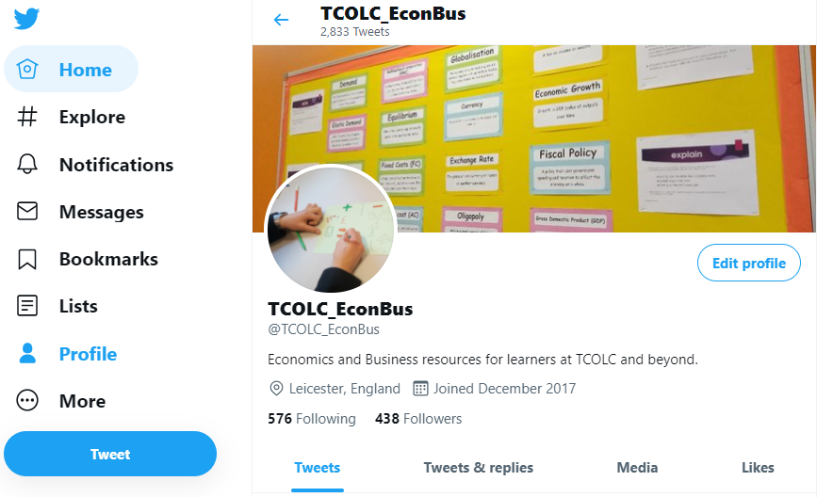
Join us on:
Twitter – tcolc_econbus
Head of Department: Mr Johal
Mjohal@cityleicester.leicester.sch.uk
Teaches of BTEC Business: Mrs Patel, Miss Garcha & Mr Patel
spatel@cityleicester.leicester.sch.uk
kgarcha@cityleicester.leicester.sch.uk
hpatel@cityleicester.leicester.sch.uk

Slide 36
Thank you!

